Slide 1
111-2 MIS241
0412 Week9

Slide 2
Outline
Completely ramdomized design
ANOVA concept & example
Follow-up analysis
0412-lab

Slide 3
Completely ramdomdized design

Slide 4
Completely Randomized Design (1 of 2)
A completely randomized design is a design in which the experimental units are randomly assigned to the k treatments or in which independent random samples of experimental units are selected for each treatment.
Notes:
Apply anova時的基本條件，須確認其實驗是完全隨機實驗 完全隨機試驗（completely randomized experiment）是指研究人員將參與者隨機分配到不同的處理組（treatment group）或對照組（control group）中，以消除實驗結果受到不同參與者個體差異的影響。在完全隨機試驗中，每個參與者都有相等的機會被分配到每一個處理組或對照組中，而且每個處理組或對照組的樣本量也應盡量相等，以減少實驗結果受到樣本大小不同所產生的影響。

Slide 5
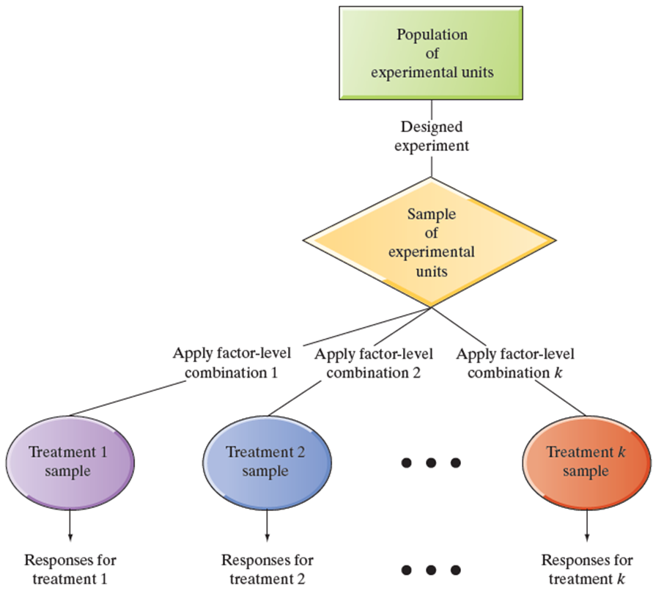
Experimental Process Overview
Designed experiment: Process and terminology

Slide 6
Completely Randomized Design (2 of 2)
Experimental units (subjects) are assigned randomly to treatments
Subjects are assumed homogeneous
One factor or independent variable
Two or more treatment levels or classifications
Analyzed by one-way Analysis of Variance (A N O V A)

Slide 7
ANOVA concept & example

Slide 8
A N O V A Basic Idea
Compares two types of variation to test equality of means
Comparison basis is ratio of variances
If treatment variation is significantly greater than random variation then means are not equal
Variation measures are obtained by ‘partitioning’ total variation

Slide 9
Example: Randomized Design - Bottled Water Brands Study
 | Factors (Bottled Water Brands)
Factor Levels (Treatments) | Brand A | Brand B | Brand C
Experimental Units | 5 random consumers | 5 random consumers | 5 random consumers
Dependent Variable (Response): Taste Preference Scale, 1-10 | 2, 5, 8, 6, 6 | 6, 7, 9, 2, 5 | 8, 4, 4, 6, 7
Notes:
Are the mean training times the same for 3 different methods?
9 subjects
3 methods (factor levels)

Slide 10
A N O V A F-Test
Tests the equality of two or more (k) population means
Variables
One nominal scaled independent variable
Two or more (k) treatment levels or classifications
One interval or ratio scaled dependent variable
Used to analyze completely randomized experimental designs
Notes:
Note:
There is one dependent variable in the ANOVA model. MANOVA has more than one dependent variable.
Ask, what are nominal & interval scales?

Slide 11
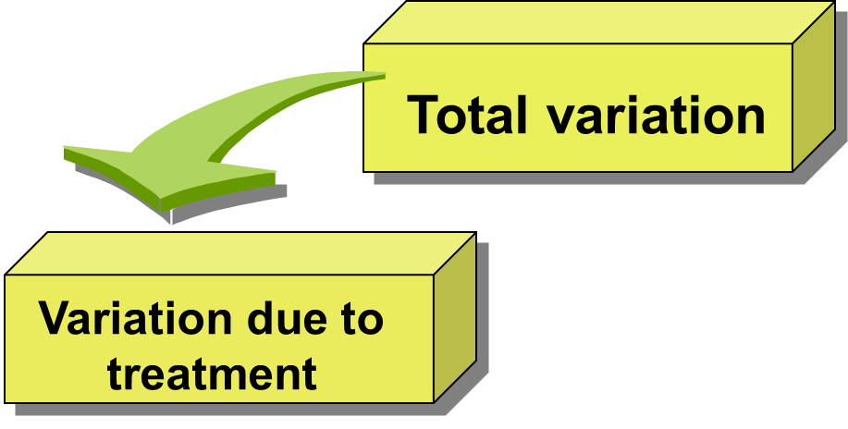
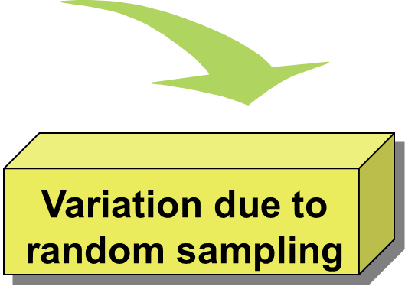
A N O V A Partitions Total Variation
Sum of Squares Among
Sum of Squares Within
Sum of Squares Between
Sum of Squares Error
Sum of Squares Treatment
Within Groups Variation
Among Groups Variation
Notes:
Variation due to Random Sampling are due to Individual Differences Within Groups.

Slide 12
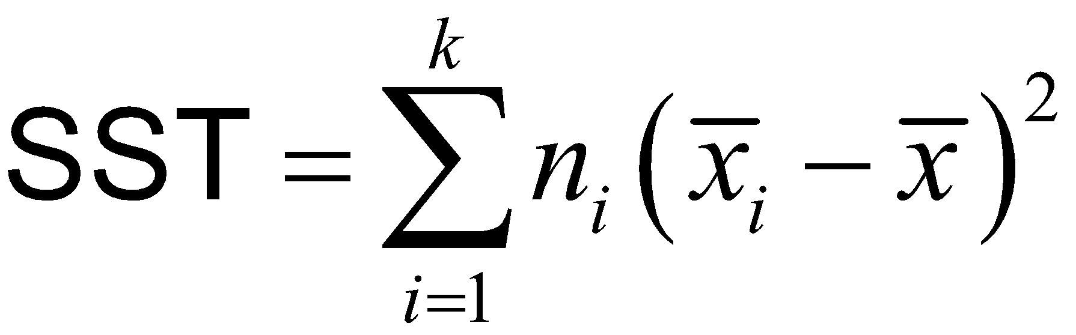
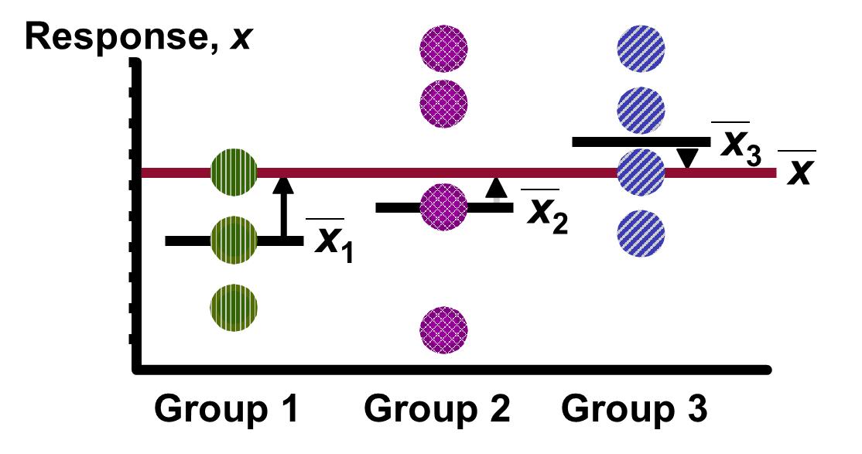
Treatment Variation

Slide 13
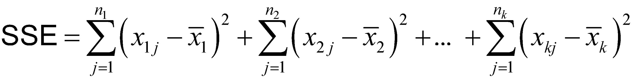
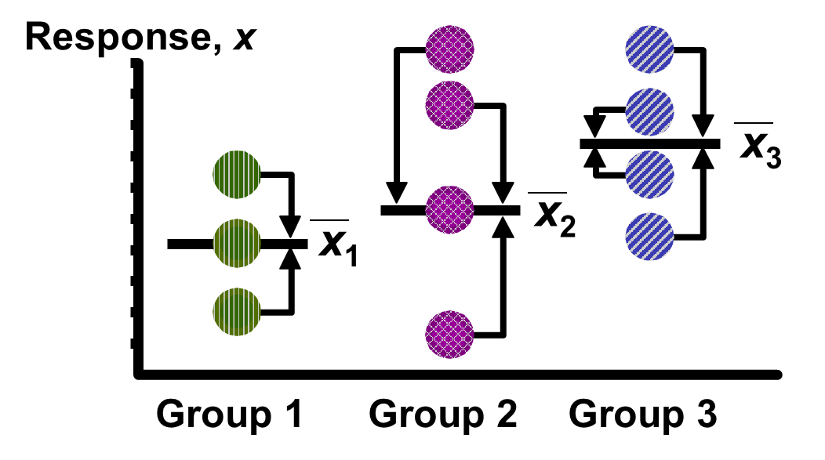
Random (Error) Variation

Slide 14

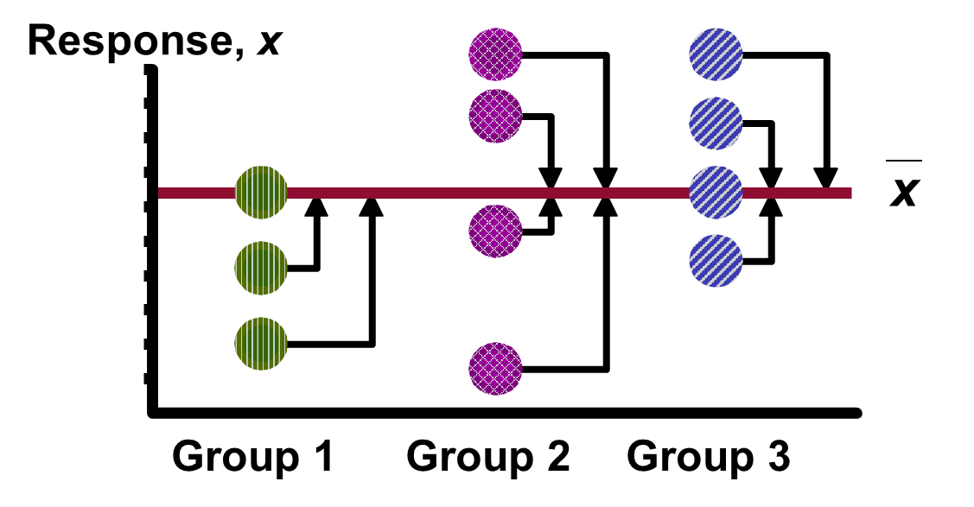
Total Variation

Slide 15

A N O V A F-Test Test Statistic
Test Statistic
M S T is Mean Square for Treatment
M S E is Mean Square for Error
Degrees of Freedom
k = Number of groups
n = Total sample size

Slide 16
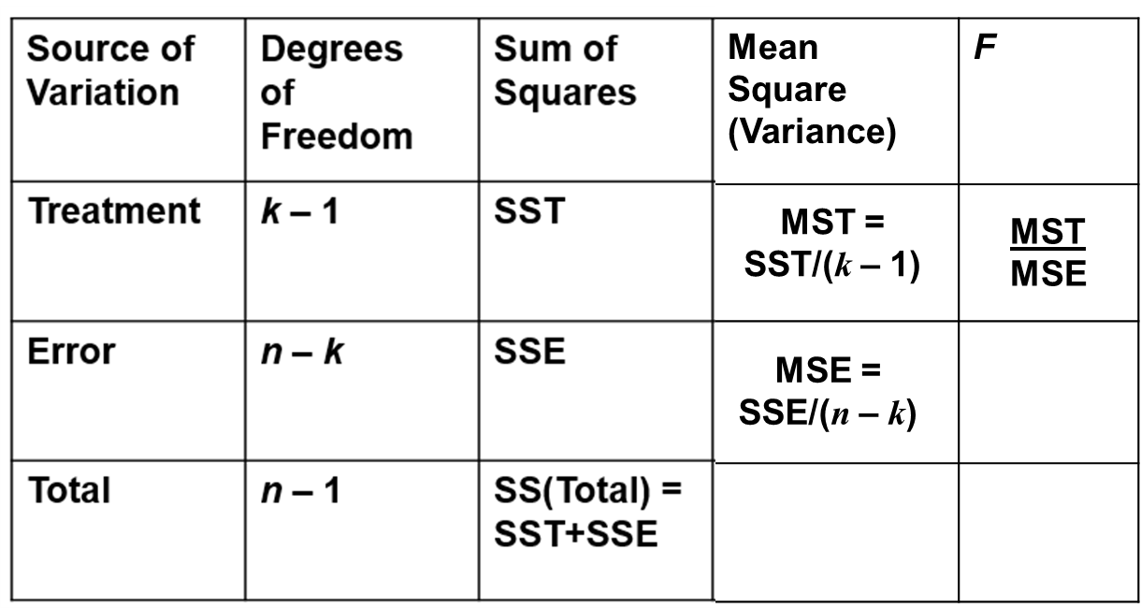
A N O V A Summary Table
Notes:
n = sum of sample sizes of all populations.
k = number of factor levels
All values are positive. Why? (squared terms)
Degrees of Freedom & Sum of Squares are additive; Mean Square is NOT.

Slide 17
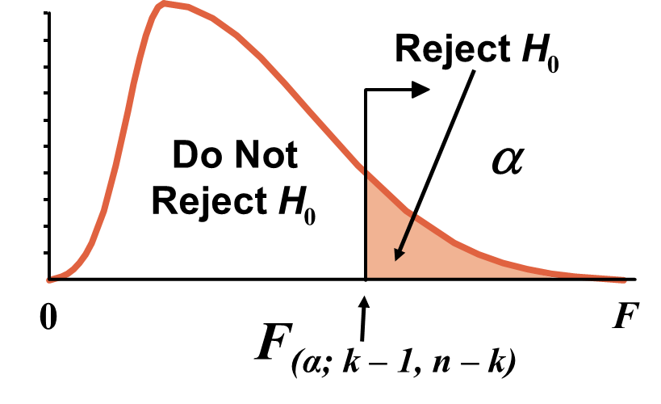
A N O V A F-Test Critical Value
If means are equal, F = MST / MSE ≈ 1. Only reject large F !
Always a one-sided tail!

Slide 18
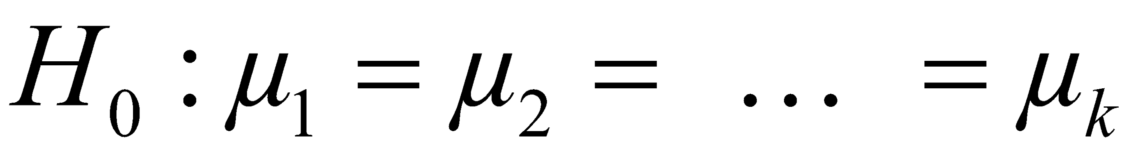
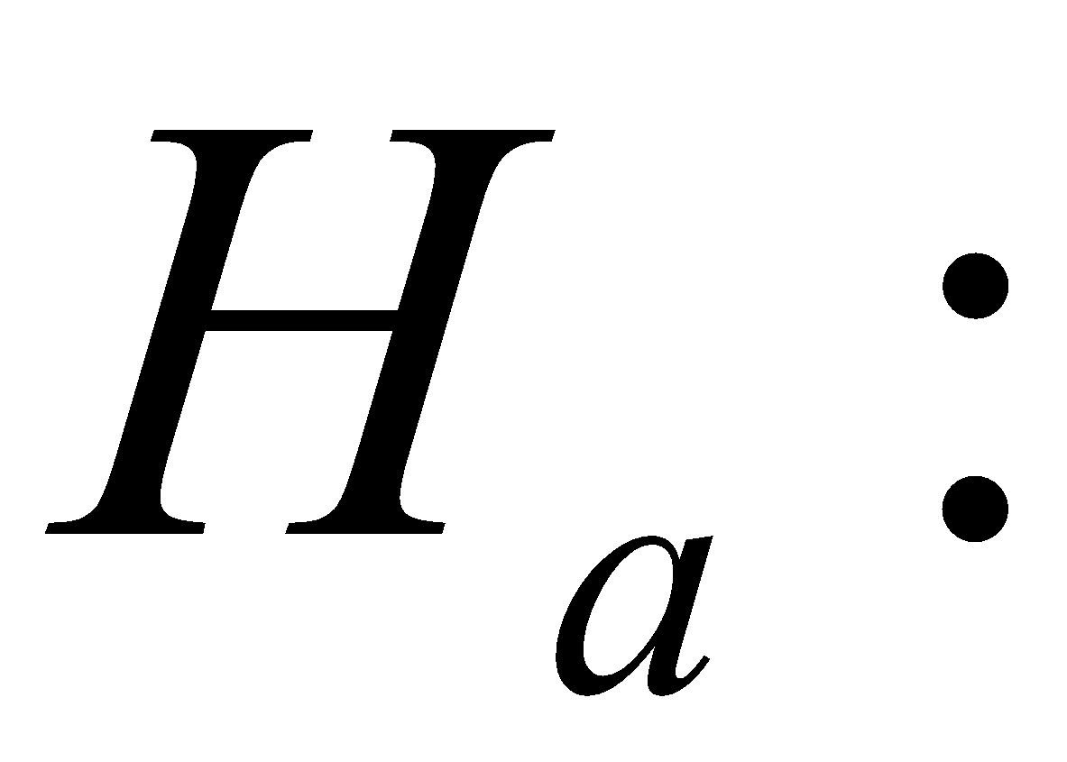
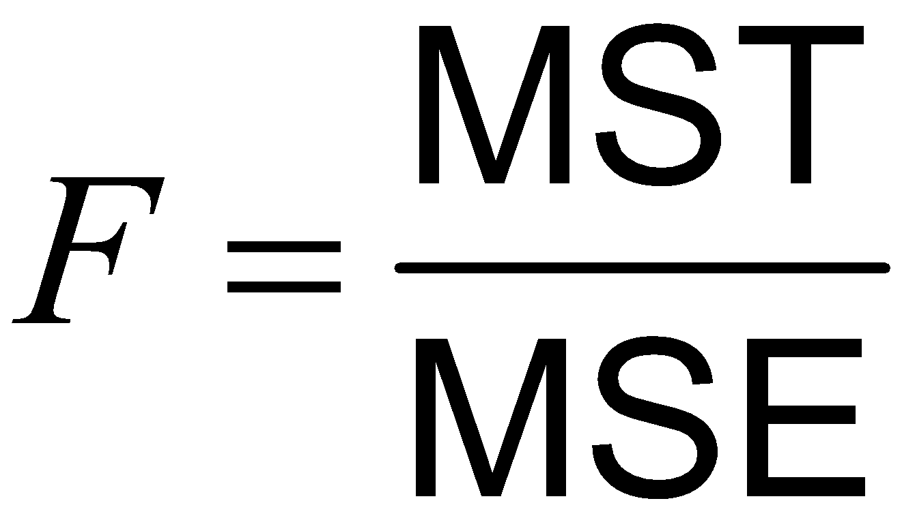

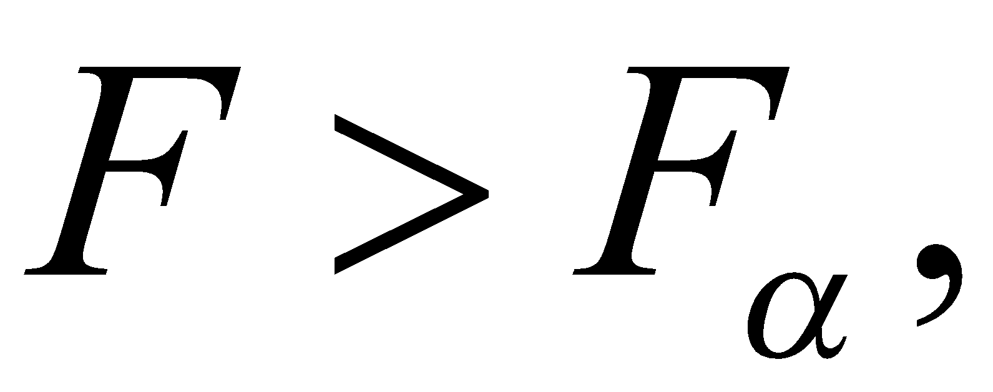
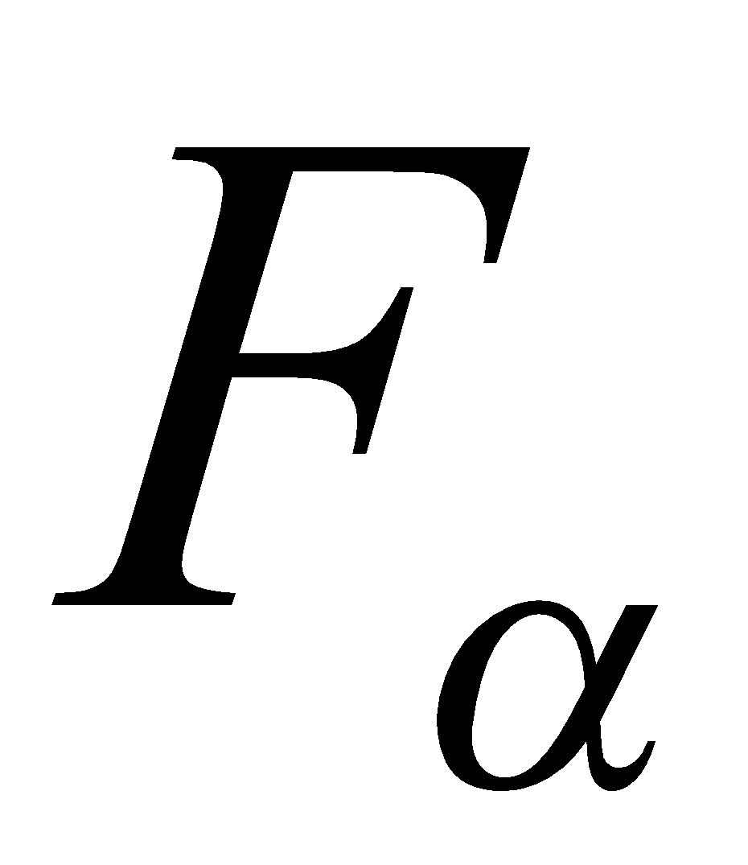
A N O V A F-Test to Compare k Treatment Means: Completely Randomized Design (1 of 2)
At least two treatment means differ
Rejection region:
where
is based
on (k − 1) numerator degrees of freedom (associated with M S T) and (n − k) denominator degrees of freedom (associated with M S E).
Notes:
Note:
There is one dependent variable in the ANOVA model. MANOVA has more than one dependent variable.
Ask, what are nominal & interval scales?

Slide 19
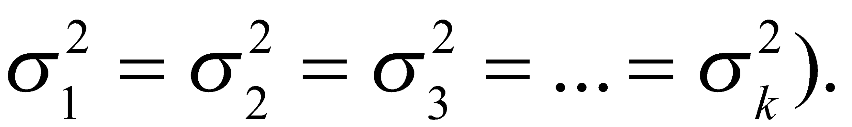
Conditions Required for a Valid A N O V A F-test: Completely Randomized Design
The samples are randomly selected in an independent manner from the k treatment populations. (This can be accomplished by randomly assigning the experimental units to the treatments.)
All k sampled populations have distributions that are approximately normal.
The k population variances are equal (i.e.,

Slide 20
Follow-up analysis

Slide 21
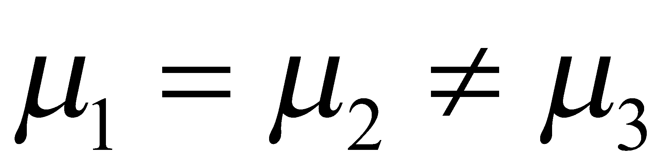
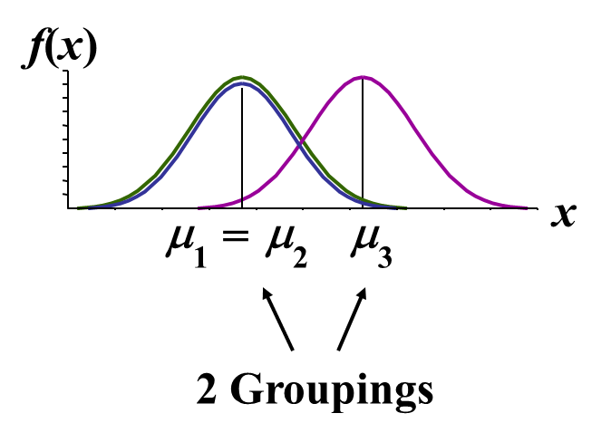
Tukey Procedure
Tells which population means are significantly different
Example:
Post hoc procedure
Done after rejection of equal means in A N O V A
Output from many statistical computer programs

Slide 22
0412-lab

Slide 23
Some rules
Snapshot your code as well as the results to WORD
Save the file as PDF
Hand over the file to CU in limited time (16:20)

